Slide 1
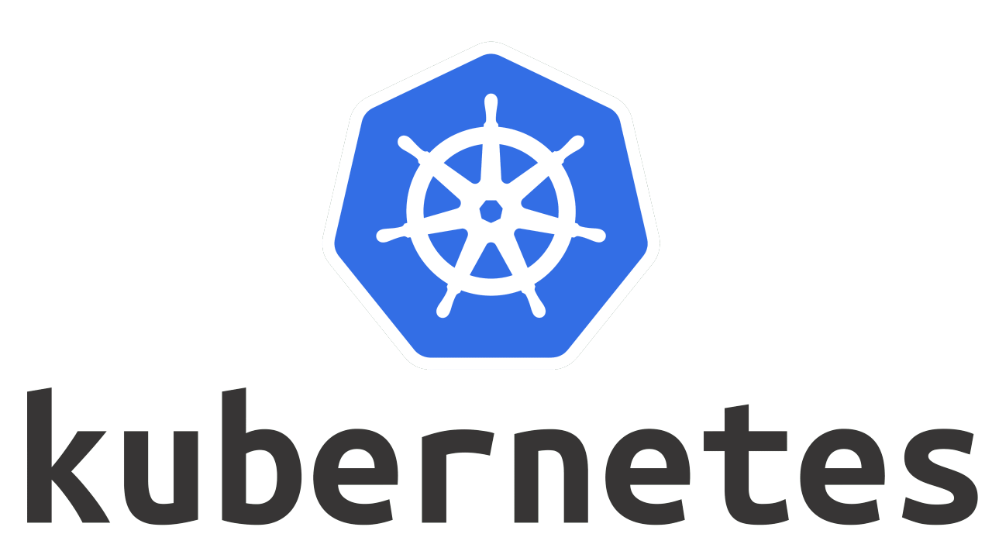
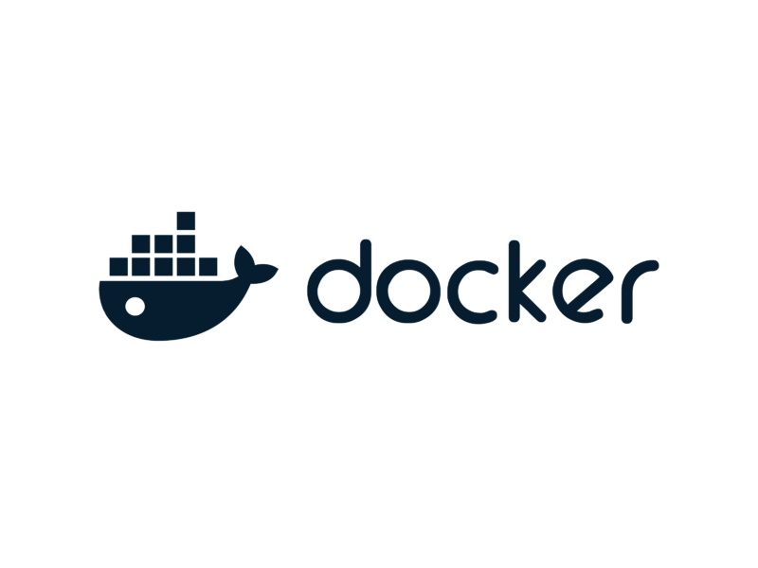
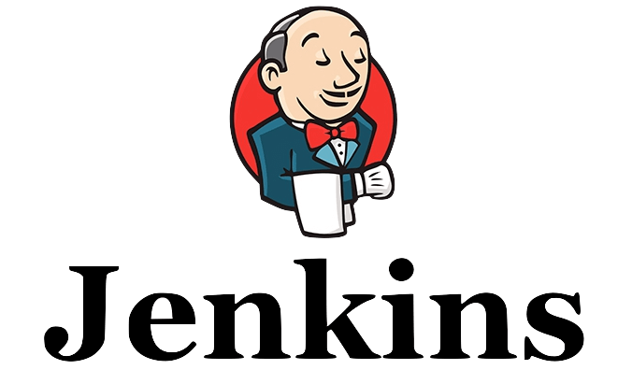
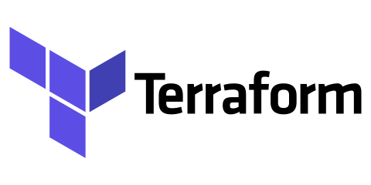


DevOps

Slide 2
Custom Resource Definition (CRD) YAML
apiVersion: apiextensions.k8s.io/v1
kind: CustomResourceDefinition
metadata:
name: locations.travel
spec:
group: travel
versions:
- name: v1
served: true
storage: true
schema:
openAPIV3Schema:
type: object
properties:
spec:
type: object
properties:
city:
type: string
country:
type: string
touristPlace:
type: string
travelType:
type: string
scope: Namespaced
names:
plural: locations
singular: location
kind: Location
shortNames:
- loc
apiVersion: travel/v1
kind: Location
metadata:
name: customer-location
spec:
city: Delhi
country: India
touristPlace: Taj Mahal
travelType: Family

Slide 3
Important Components of a Server and Their Functions
CPU (Processor)
The brain of the server.
Executes instructions and processes requests from applications and users.
RAM (Memory)
Temporarily stores data that the CPU needs quickly.
Helps run applications and services smoothly.
Storage (HDD / SSD / NVMe)
Stores the operating system, applications, and data permanently.
Often configured with RAID for reliability.
Motherboard
The main circuit board that connects all components like CPU, RAM, storage, and network cards.
5.Power Supply Unit (PSU)
Provides electrical power to all server components.
Many servers use redundant power supplies for high availability.
6.Network Interface Card (NIC)
Allows the server to connect to a network or the internet.
Handles data communication between the server and clients.
7.Cooling System (Fans / Heat Sinks)
Maintains proper temperature to prevent overheating during continuous operation.
8.RAID Controller
Manages multiple storage drives to improve performance and provide data redundancy.

Slide 4
Why a Server is Required Instead of Just a Laptop or Personal Computer
24/7 Availability – Servers are designed to run continuously without shutdown, while laptops/PCs are usually used for personal tasks and not meant for constant operation.
Higher Reliability – Servers use enterprise-grade hardware (ECC RAM, RAID storage) to reduce crashes and data loss.
Better Performance for Many Users – A server can handle multiple users or requests simultaneously, while a laptop/PC is optimized for a single user.
Centralized Resource Management – Servers store applications, databases, and files in one place so many users or systems can access them.
Scalability – Servers can be upgraded easily (more CPU, RAM, storage) to handle increased traffic or workload.
Advanced Security – Servers include strong security controls like firewalls, access control, and monitoring to protect data.
Backup and Data Protection – Servers support automated backups, redundancy, and disaster recovery features.
Network Services – Servers run important services like web hosting, databases, authentication, and APIs for other systems or users.

Slide 5
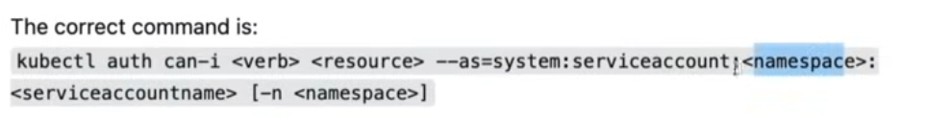
Kubectl auth can-i get pods -- as=<service account name> -n namespoace
Kubectl auth can-i <verb> <Resources> -- as=<service account name> -n namespace

Slide 6


Slide 7
Level 1 Kubernetes Basics
Kubernetes History
– Traditional server, VM Ware, cloud, DevOps (SDLC) – Docker & Kubernetes
Kubernetes Role and Advantage – microservices, Auto Scaling & Self healing
Kubernetes Architecture
Kubernetes Types
Kubeadm (multiple EC2) , Kind Cluster (K8S in Docker, Mini Kube (Local or single EC2)
Managed Cloud Services: EKS, AKS & GKE
Setup & Install
Resources

Slide 8
Level 2 Kubernetes Workload & Network
Workload
Storage
Network
Scaling
RBAC
CRD – Customer Resources Definition
Cluster Upgrade

Slide 9
Level 3 Advance
Helm
Operators
Service Mesh
Kubernetes API
Monitoring

Slide 10
KUBERNETES
Traditional Server & VM Ware
Cloud
DevOps (SDLC)
Docker
Kubernetes

Slide 11
Traditional Server
Physical Server (Hardware)
Company buys server.
This server usually sits in data center or company’s server room
The server contains:
CPU
RAM
Hard Disk
Network connection
Everything runs on one machine.
Application / Website is Deployed
Developers build a website or application using technologies like:
Node.js
.NET
PHP
Java
Python
The application is then installed (deployed) on the server.
Example stack:
OS → Linux / Windows Server
Web Server → Apache / Nginx / IIS
Application → Node.js / .NET
Database → MySQL / SQL Server
Domain Name
Every server has an IP Address connected to Domain Name using DNS
Example
Server IP: 192.168.1.10
www.mariettyjt.com

Slide 12
User Browser
↓
Domain Name (example.com)
↓
DNS → Server IP
↓
Physical Server
↓
Web Server (Apache / IIS / Nginx)
↓
Application (.NET / Node.js)
↓
Database
↓
Response to User

Slide 13
Kubernetes
Basic
Microservices
Self healing
Auto Scaling
Architecture
Install Setup types
(Kubeadm. Mini Kube, Kind)
(Cloud: EKS, AKS & GKE etc)
Resources
Workload
Network
Storage
Scaling
Advance
RBAC
Service mesh
CRD
Helm
Monitoring

Slide 14
SDLC
To design, develop, test, and deploy high-quality software efficiently.
Agile Model
Waterfall Model
DevOps
Spiral Model
Etc

Slide 15
Important DevOps Tools
Git, GitHub – Repository
Docker, DockerHub - Container
Kubernetes – Cluster
Jenkins – CI/CD
IAC - Code as Infrastructure
Terraform
Ansible
Prerequires
Linux,
Networking &
AWS Cloud
Maven
Trivy
SonarQube
Monitoring
Prometheus & Grafana

Slide 16
Kubernetes Architecture
2014 Borg (Google)
Self Healing
Auto Scaling
Orchestration tools
Docker container Networking
CNCF – Cloud Native Computing Foundation
Monolithic vs Microservices

Slide 17
The main types of Services in kubernetes
ClusterIP (Default)
Exposes the Service inside the cluster only.
Pods can communicate with each other using this IP.
Not accessible from outside the Kubernetes cluster.
Use case: Internal communication (e.g., backend → database).
LoadBalancer
Exposes the Service using a cloud provider’s load balancer.
Automatically assigns an external IP.
Internally uses NodePort + ClusterIP.
Use case: Production applications on cloud (AWS, Azure, GCP).
NodePort
Exposes the Service on a static port on each Node.
Accessible using: NodeIP : NodePort
NodePort range: 30000–32767
Use case: Basic external access for testing or small setups.
ExternalName
Maps the Service to an external DNS name.
No Pods or selectors involved.
Returns a CNAME record.
Use case: Access external services (like RDS, external APIs) using Kubernetes Service name.
Headless Service (Special Case)
Created by setting clusterIP: None.
No load balancing.
Returns individual Pod IPs.
Use case: Stateful applications (e.g., StatefulSets like MongoDB, Kafka).

Slide 18
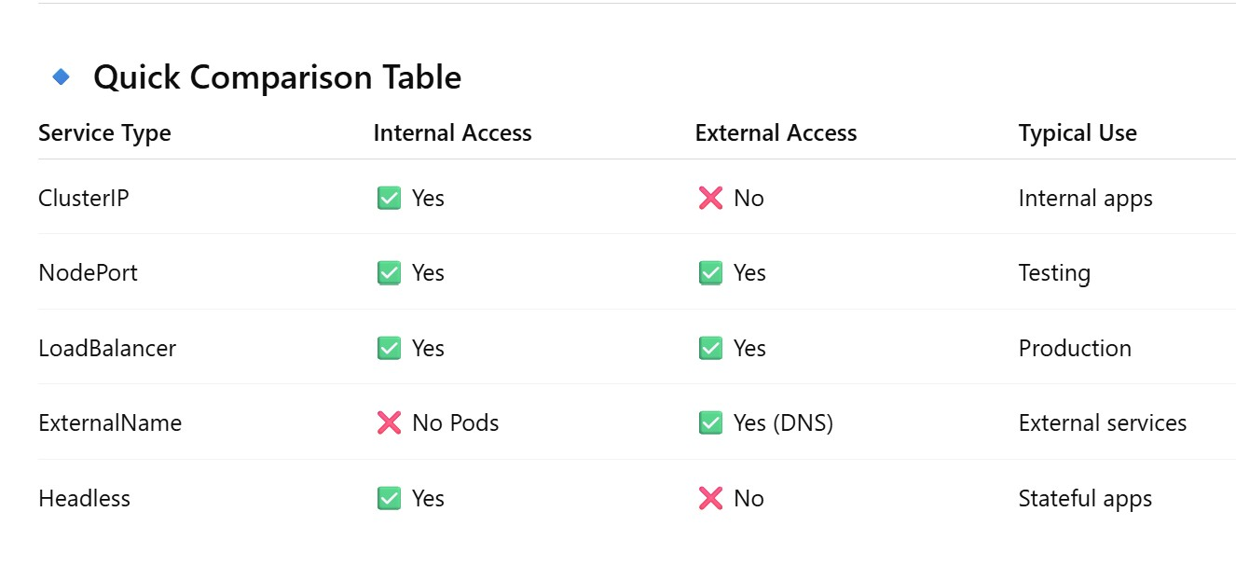

Slide 19
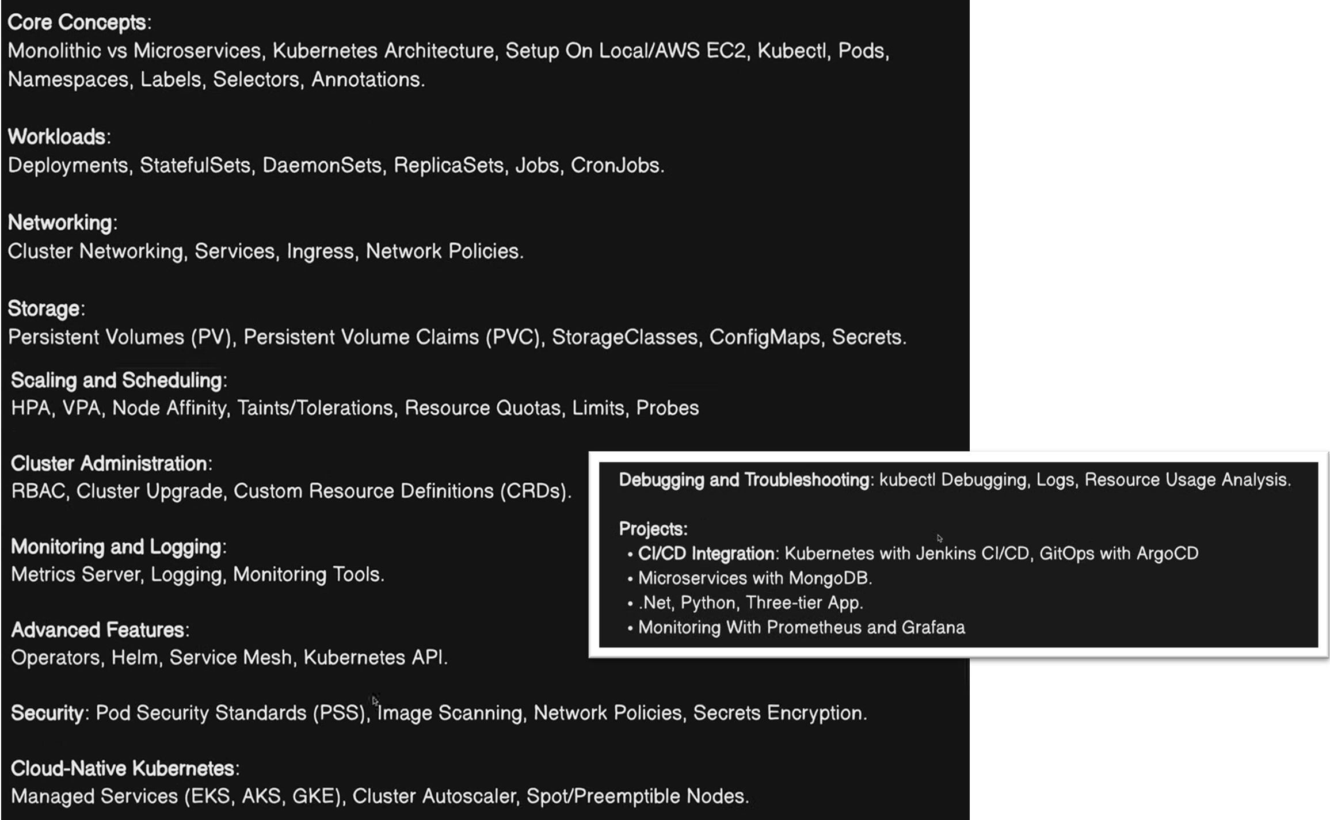

Slide 20
Kubernetes Introduction
2014 Borg (Google)
Healing
Scaling
Orchestration tools
Docker container Networking
CNCF – Cloud Native Computing Foundation
Monolithic vs Microservices

Slide 21
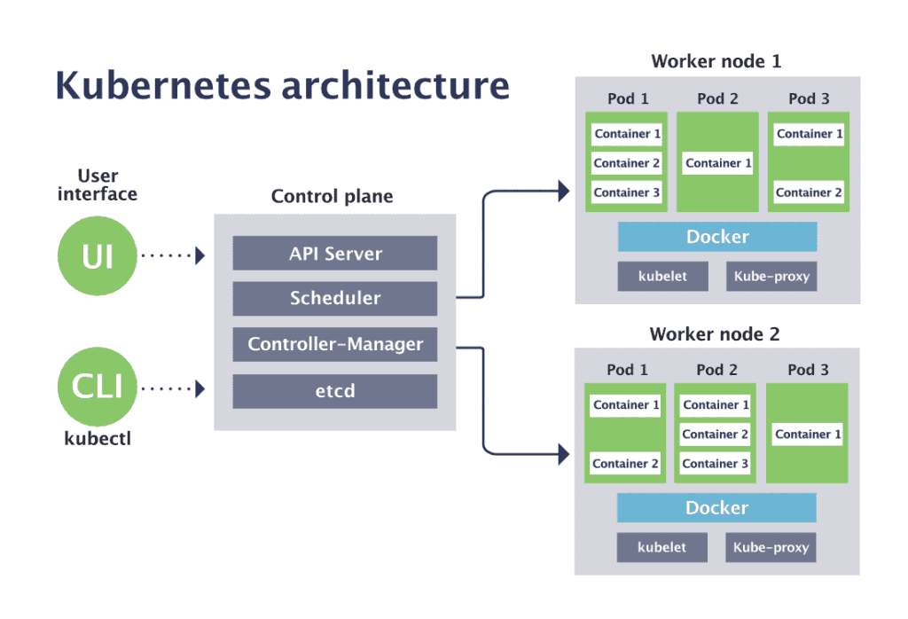
Kubernetes Architecture
Master–Worker (Control Plane–Node) architecture.
Control Plane (Master Node) → Manages the cluster
Worker Nodes → Run the application workloads (Pods)
Control Plane (Master Node) Components
decide WHAT should run and WHERE.
kube-APIServer (Communication Gateway)
🔹 Function:
Acts as the front door of the Kubernetes cluster
All commands go through the API Server
Communicates with:
kubectl
Scheduler
Controller Manager
kubelet
🔹 Key Points:
Validates requests
Authenticates & authorizes (RBAC)
Updates etcd
📌 If API Server is down → cluster is unusable

Slide 22
Kubernetes Architecture
Kubectl - Kube controller
Worker Node 1
Kubernetes Cluster
Pod 1
Pod 2
Pod 3
Kubelet
Container 1
Container 1
Container 1
Master Node
Container 2
Container 2
Kube proxy
Container 3
Scheduler
- Create Pon in Worker Node
API Server
- Communication Gateway with All service like sch, etcd
Worker Node 2
ETCD
– Store All Data
Pod 1
Pod 2
Pod 3
Container 1
Container 1
Container 1
Container 2
Container 2
Controller Manager
- Track the status on pod, node & cluster etc
Container 3
Kubelet
Kube proxy
Monitor Worker Node
Network Service
Worker Node 3
Container Network Interface CNI Network: Weave net, Calico

Slide 23
API – Application Programable Interface
Integrated Development Environment (IDE)

Slide 24
kubectl
kube-apiserver
etcd <---- cluster state stored
kube-scheduler
kube-apiserver (node assigned)
kubelet (on worker node)
Container Runtime
Container Created inside Pod
kube-proxy (network rules)
User
Request New Container through yml file

Slide 25
2 - etcd (Cluster Database)
🔹 Function:
Key-value store for entire cluster state
Stores:
Pod definitions
Secrets & ConfigMaps
Node info
Cluster configuration
🔹 Key Points:
Single source of truth
Needs regular backup (CKA exam favorite)
Highly consistent & reliable
📌 If etcd data is lost → cluster state is lost
3 - kube-scheduler
🔹 Function:
Decides which Pod runs on which Node
🔹 How it works:
Watches for Pods with no node assigned
Selects best node based on:
CPU & Memory
Taints & Tolerations
Node affinity
Resource availability
📌 Scheduler does not run pods — it only assigns nodes
4 - kube-controller-manager
🔹 Function:
Ensures desired state = actual state
🔹 Controllers inside it:
Node Controller
ReplicaSet Controller
Deployment Controller
Job Controller
Endpoint Controller
🔹 Example:
If a Pod crashes → controller creates a new one
📌 Controllers continuously monitor and correct the cluster
5 - cloud-controller-manager (Optional)
🔹 Function:
Integrates Kubernetes with cloud providers (AWS, Azure, GCP)
🔹 Manages:
Load balancers
Cloud storage volumes
Node lifecycle
📌 Not used in on-prem clusters

Slide 26
3️⃣ Container Runtime
🔹 Function:
Runs containers inside Pods
🔹 Examples:
containerd (most common)
CRI-O
Docker (deprecated)
📌 Kubernetes does NOT run containers directly
4️⃣ Pods
🔹 Function:
Smallest deployable unit
One or more containers sharing:
Network
Storage
Lifecycle
🔄 How Everything Works Together (Flow)
User runs kubectl apply
Request goes to API Server
API Server stores config in etcd
Scheduler assigns Pod to a Node
kubelet creates Pod using container runtime
kube-proxy sets up networking
Controllers continuously monitor state
Worker Node Components
Worker nodes run the actual applications.
1️⃣ kubelet
🔹 Function:
Agent running on each worker node
Communicates with API Server
Ensures containers are running as defined
🔹 Responsibilities:
Creates Pods
Monitors Pod health
Reports node status
📌 If kubelet stops → node becomes NotReady
2️⃣ kube-proxy
🔹 Function:
Handles networking
Enables communication:
Pod → Pod
Pod → Service
External → Service
🔹 Works using:
iptables / IPVS
📌 Implements Service abstraction

Slide 27


